Slide 1
ROBOCUP PRESENTATION PROJ802 OMNI_ROBOT
HERNANDEZ Camilo
Student Group : BOUTEUMEUR Dina
BRISSON Thibaud

Slide 2
Summary
Previous work
CAD Omni Robot
URDF Generation
Controllers & Plugins
PID of the joints
Gazebo Simulation
Nodes
GitHub

Slide 3
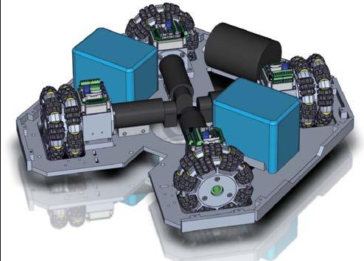
Previous work
Omar Robot Design
Previous Nodes
Avoiding obstacle
Detect the ball
Move to the ball
Overall of a ROS architecture

Slide 4
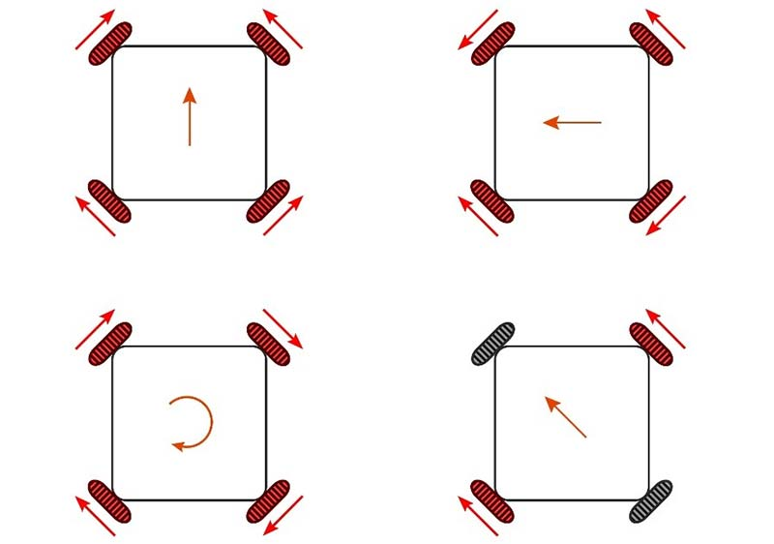
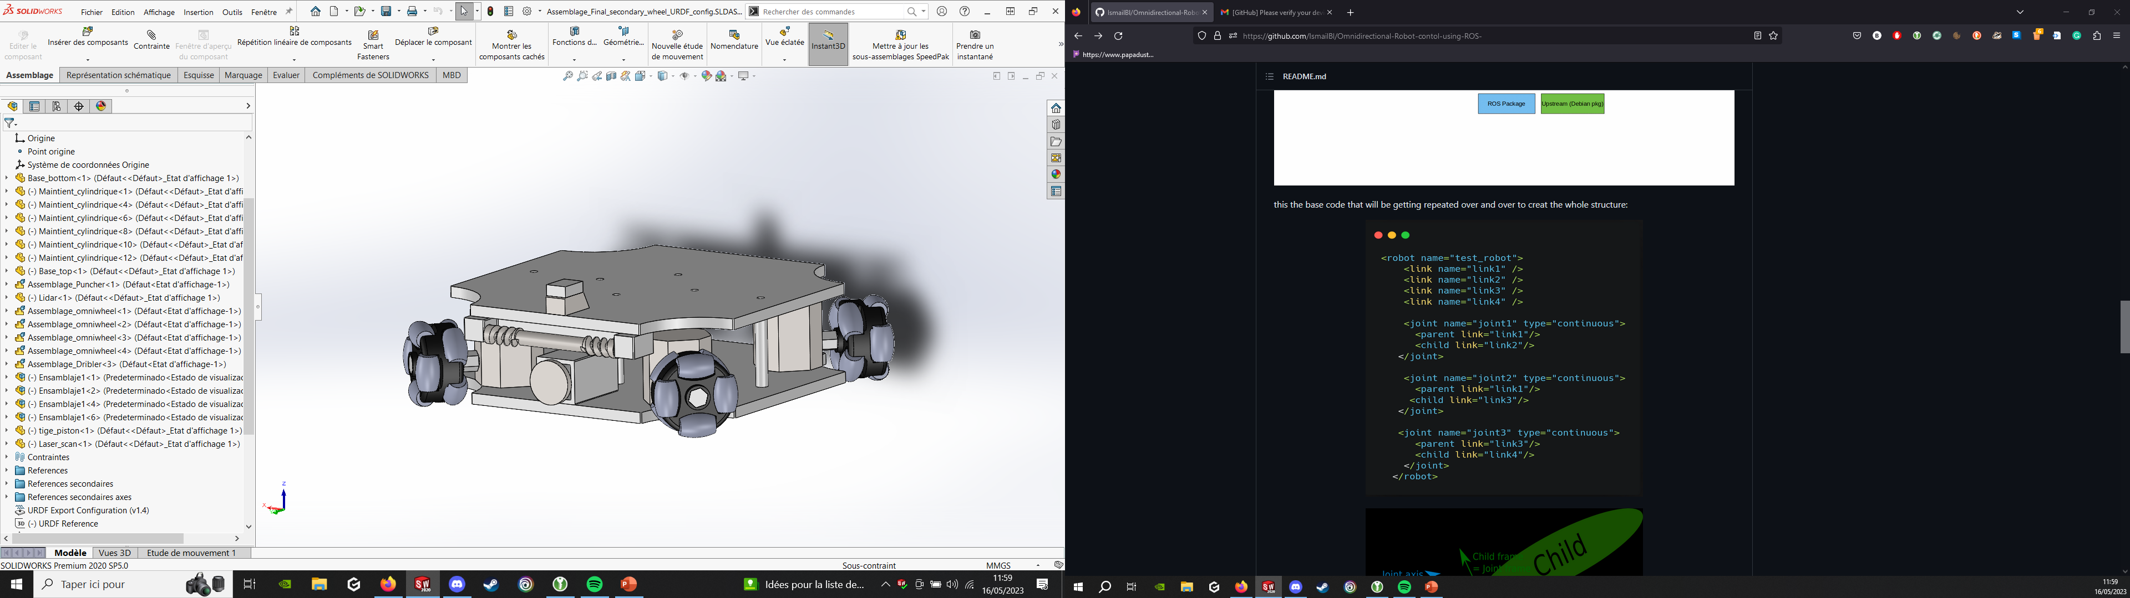
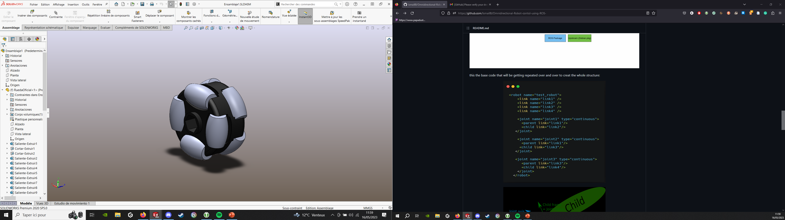
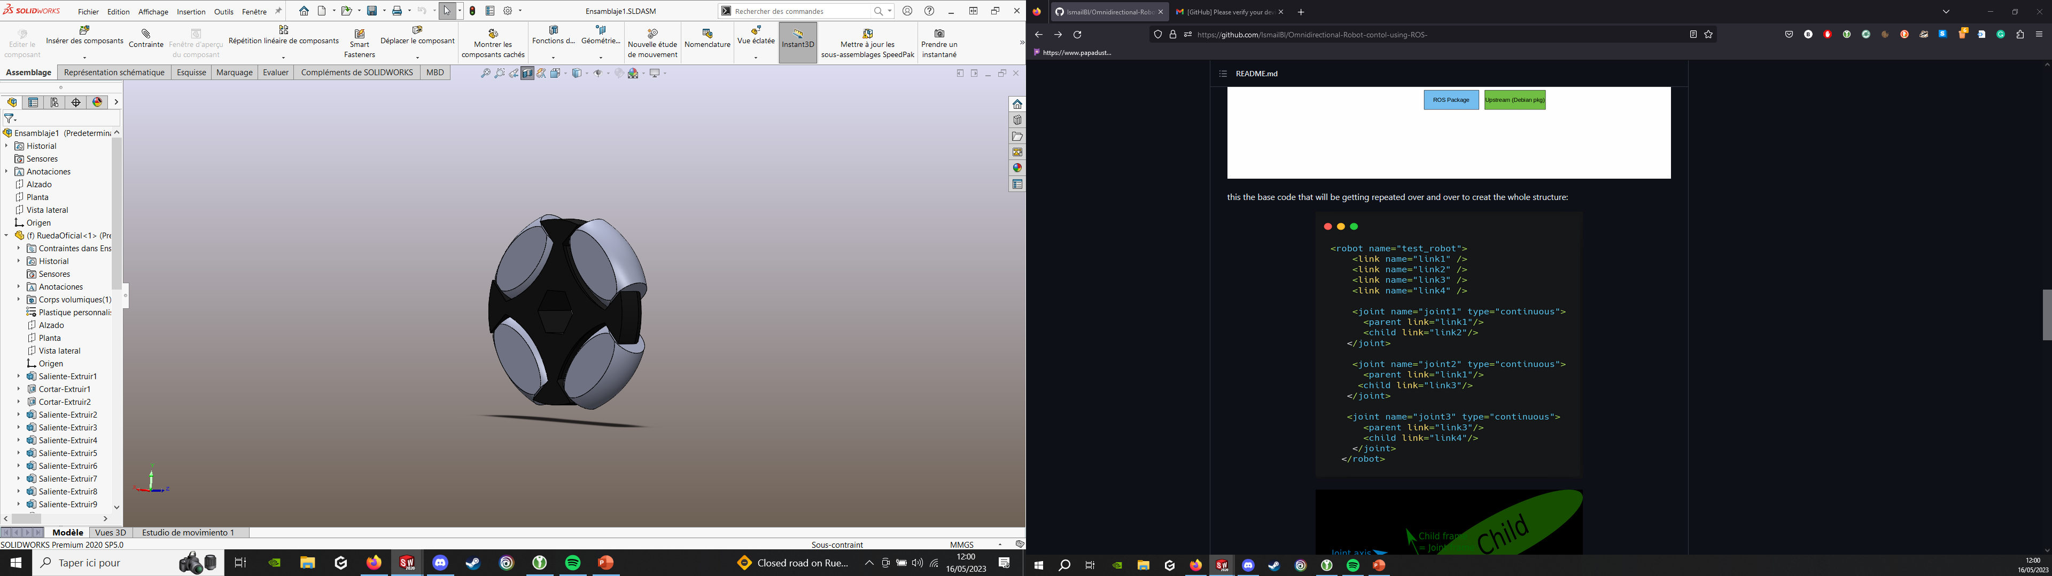
CAD Omni Robot

Slide 5
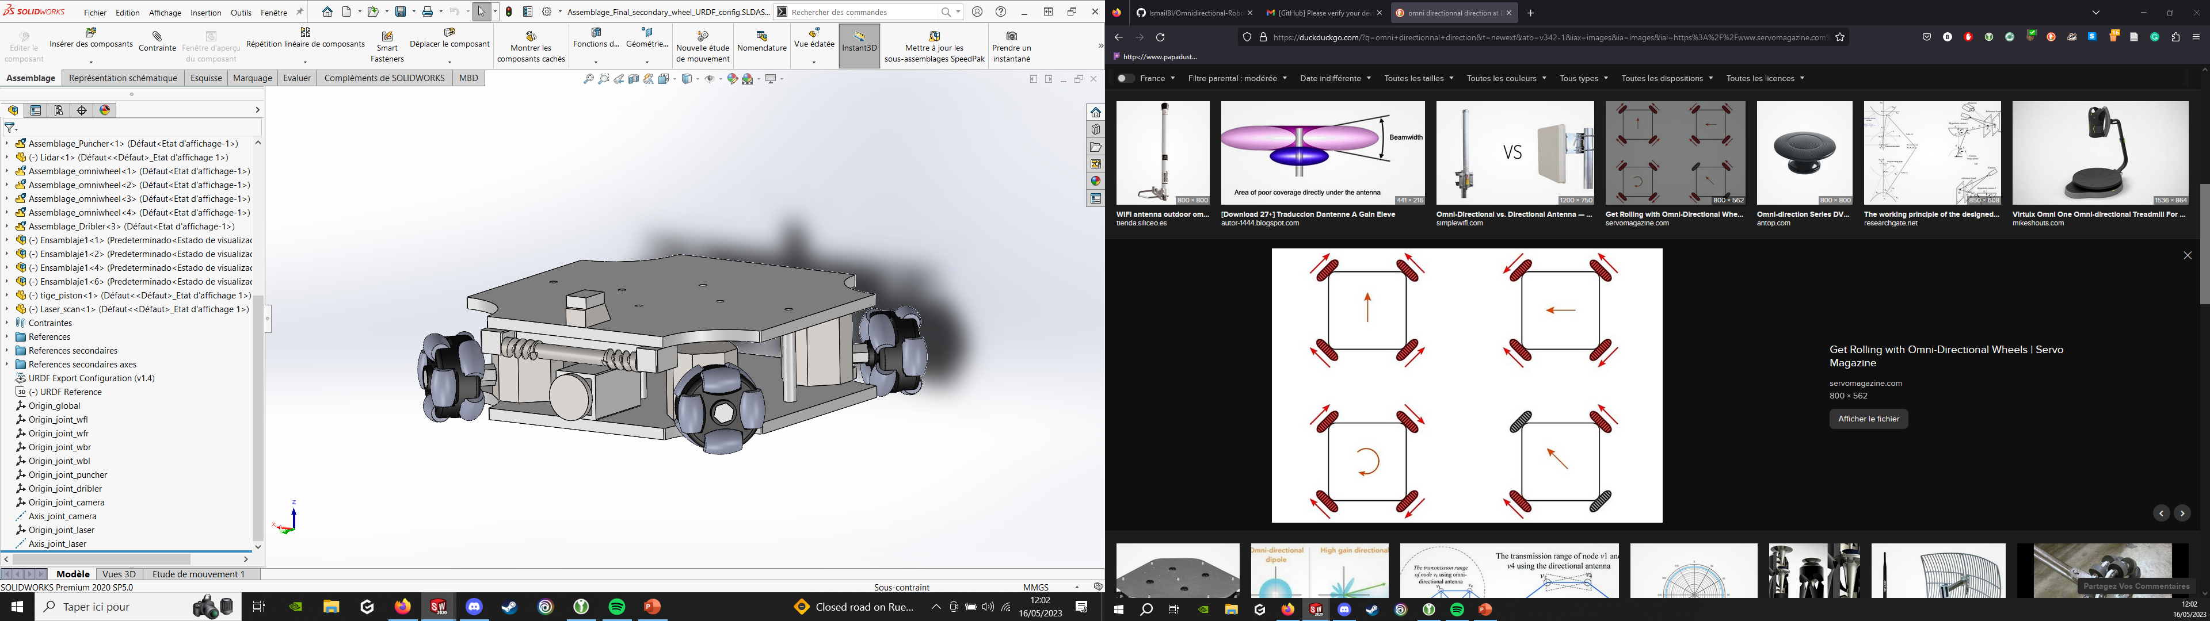
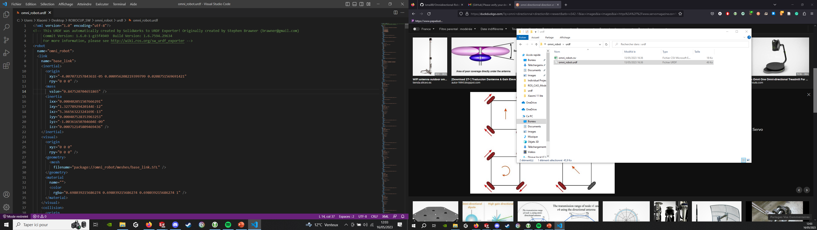
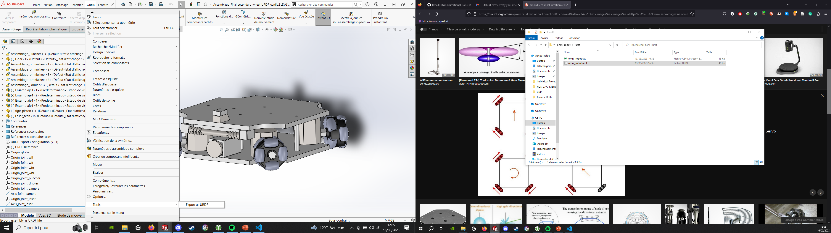
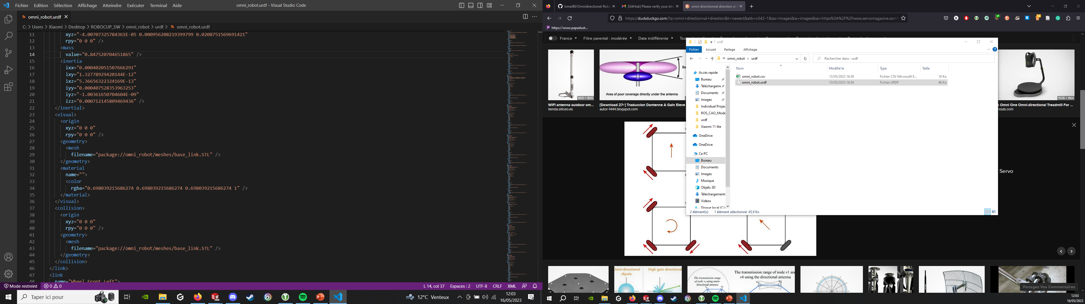
URDF Generation
URDF export Tool

Slide 6
Controllers & Plugins

Slide 7
PID of the joints

Slide 8
Gazebo Simulation

Slide 9
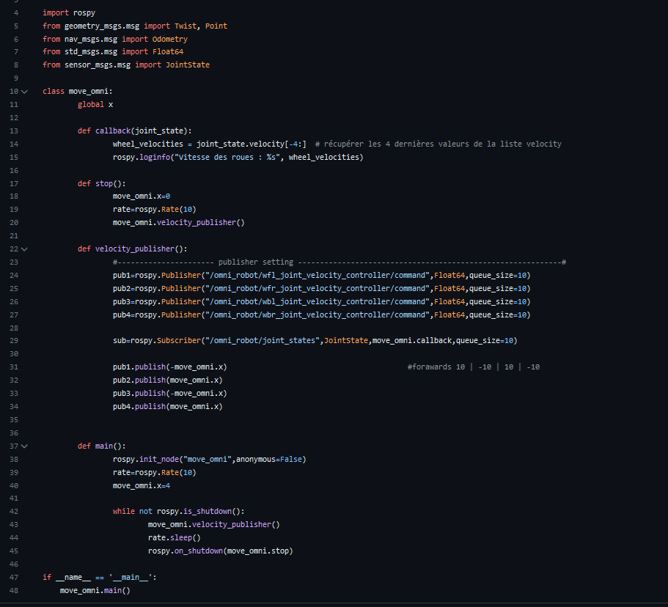
Nodes
Move_omni
OpenCv_Ball_detection
Move_to_ball

Slide 10
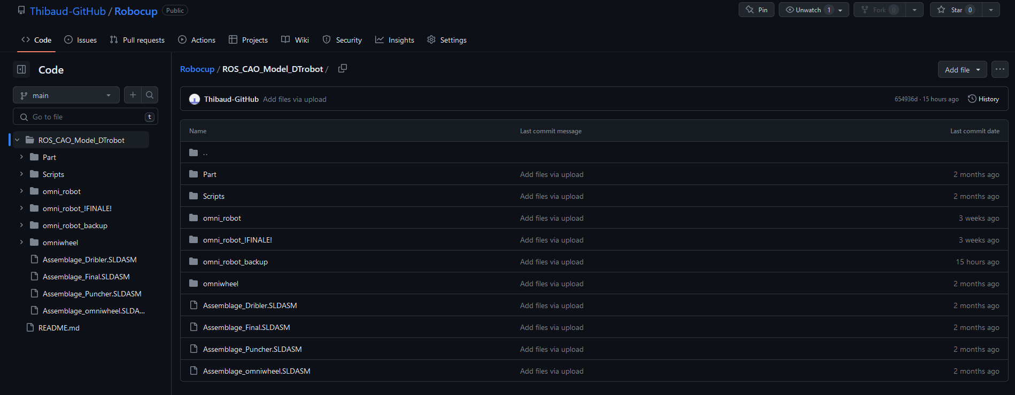
GitHub
Regular update
Easiest and efficient way to share information inside the group

